Slide 1
New Organisational Safeguarding Procedure Webinar for Registered Managers, Nominated Individuals in Provider Services & Designated Safeguarding Leads in Partner Organisations
Nicola Webb Safeguarding Policy and Development Officer, Safeguarding Adults Team
Fiona Hewison Senior Practitioner Safeguarding Adults
Nicola Dixon Quality and Service Continuity Team
James Harris Quality and Service Continuity Team
Notes:
Nicola W

Slide 2
Plan for the session
Welcome and introductions
A copy of presentation and resources will be available on the NYSAB website from 1st October
Questions - please use the chat box and there will be an opportunity to ask questions at the end
This Photo by Unknown Author is licensed under CC BY-NC-ND

Slide 3
What we will cover
The changes with the new Organisational Safeguarding procedure and roles of partner organisations
How to refer concerns about quality (care and support provision) and safeguarding
What is organisational abuse, including signs and indicators?
Orgainsational Safeguarding Procedure - The new five stage process & resources
The Quality Pathway - North Yorkshire Council
Notes:
NW

Slide 4
Key changes
The new Organisational Safeguarding Procedure has been developed by a multi-agency task and finish group and replaces “Collective Care” procedures. It has been approved by North Yorkshire Safeguarding Adults Board.
Five stage process which has a clear “end to end” process,
We no longer have low-level concerns meetings, these are now part of the Quality Pathway.
A multi-agency supportive approach which identifies interventions required to enable providers to meet standards of care
Supports transparent decision making where there are concerns about organisational abuse or neglect and quality of care issues
Includes timescales which supports a proportionate response to concerns
Ensures risk is proportionately assessed including the impact on people using the service
Strengthens accountability
Providers produce a Provider Improvement Plan – this is a new stage
Pathway which will promote and drive sustainability in the adult social care market in North Yorkshire
Notes:
NW

Slide 5
The old and the new
Process up to 30 September 2024 Collective Care | New Process from 1 October 2024 Organisational Safeguarding
Strategy meeting (Collective care) | Decision to initiate Organisational Safeguarding
Case conference meeting (Collective care) | Initial Organisational Safeguarding meeting
3. Review meeting (Collective care) | 3. Provider Review meeting
 | 4. Quality Assurance
 | 5. Exit to the Quality Pathway
Notes:
NW

Slide 6
Which providers does the Organisational Safeguarding procedure apply to?
Any care or health provider who delivers care and support to a group of people. Which may include:
Domiciliary Care Providers/ Home based support
Residential Care Homes
Nursing Homes
Supported Living
Extra Care
Private Hospitals
NHS Provision - secondary care
Day Care opportunities/Providers
Residential colleges
Voluntary & Community Services (VCS)
Notes:
Nicola W
The Registered Manager/ Nominated Individual of provider services, is the point of contact for organisational safeguarding and will be invited to attend the initial organisational safeguarding meeting and review meetings.

Slide 7
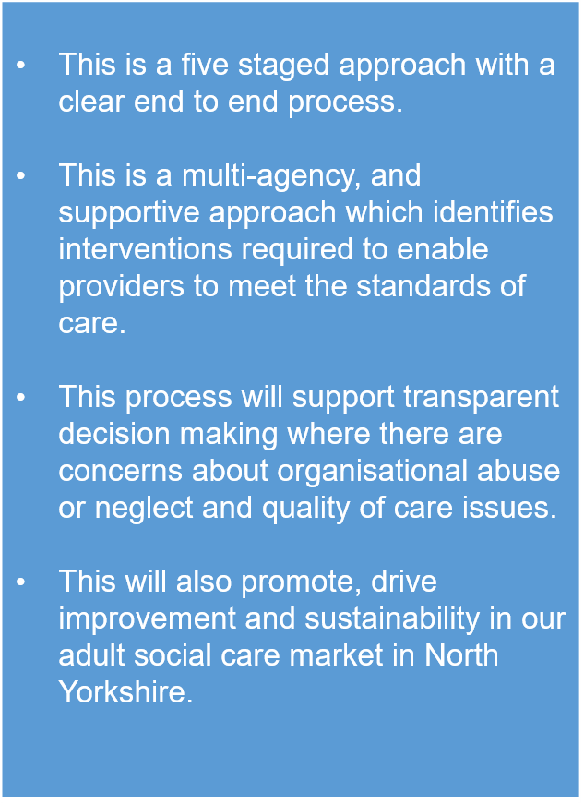
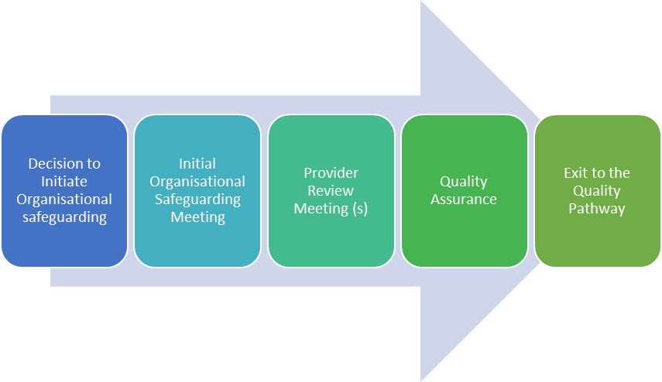
Organisational Safeguarding Procedures New five staged approach
Notes:
Nicola

Slide 8
Quality Team & The Quality Pathway
The Quality Pathway has been developed to have a clear end-to-end process to support a risk-based approach to quality intervention in the market.
Humber and North Yorkshire Health and Care Partnerships & North Yorkshire Council have developed an integrated approach to quality assurance and quality improvement.
The integrated Quality Team will bring together Quality Nurses, Quality Improvement and Quality Assurance Officers offering a wide set of skills to our care market. A risk-based approach is used to support providers. The Quality Team will use the same RAG rating to determine risk.
There are different types of Quality Assurance visit to support a risk-based approach. Providers will no longer request a visit to a service but provide the intelligence to the Quality Team for them to determine the most appropriate intervention by the team.
When there are concerns initial information gathering/risk assessment approach with Adult Social Care and the Quality team will determine the next steps either the Organisational Safeguarding process or Quality Pathway.
Notes:
Nic and James

Slide 9
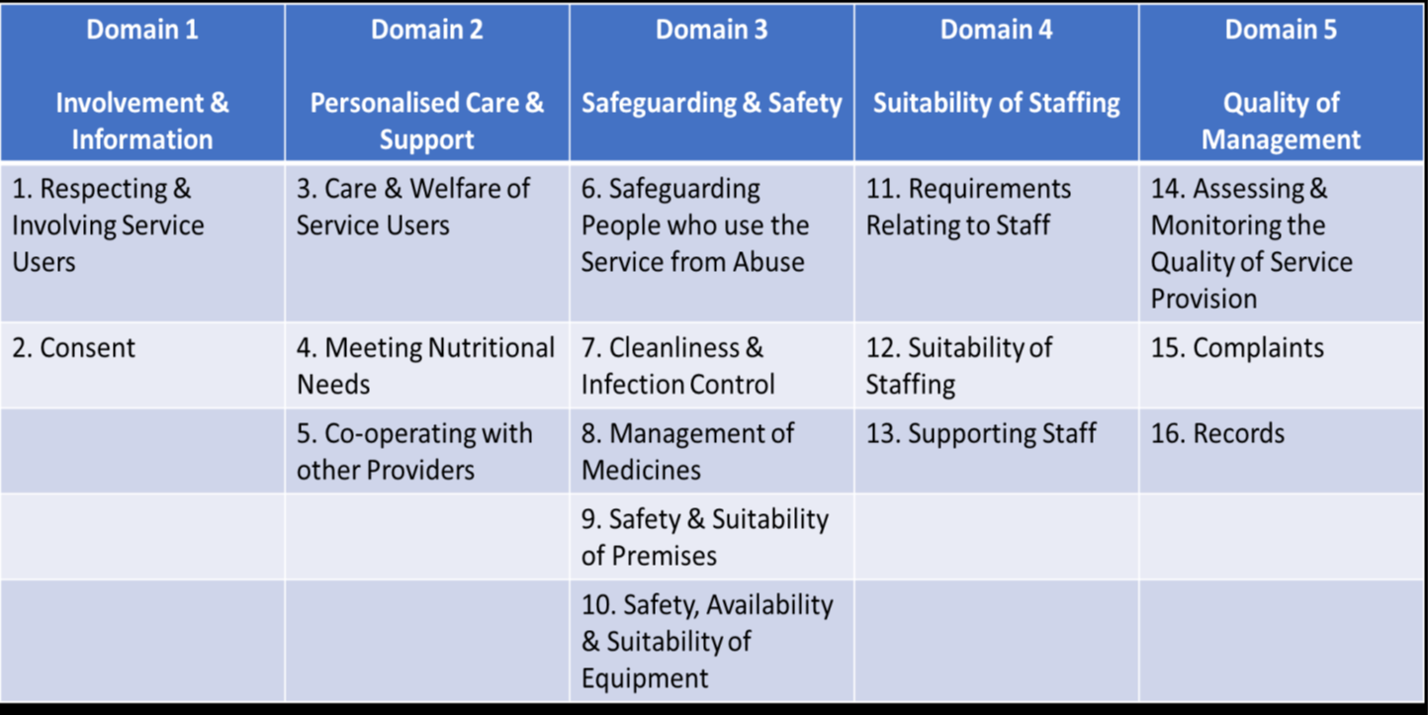
Quality Assurance Standards and Outcomes
The Quality Assessment Tool is be used to assess the Provider’s performance against the requirements of the Quality Pathway and the Standards and Outcomes Framework.
Assessment Criteria
Fully Met | 90-100% | The Service is performing exceptionally well and has fully met the requirements of the Framework.
Almost Met | 71-89% | The Service is performing well and has almost met the requirements of the Framework.
Partially Met | 50-79% | The Service is not performing as well as it should and has partially met the requirements of the Framework.
Not Met | 0-49% | The Service is performing poorly and has not met the requirements of the Framework.
Notes:
Nic and James
The Standards and Outcomes Framework within the Approved Provider List Contract is made up of 5 overarching Domains:
Involvement & Information
Personalised Care & Support
Safeguarding & Safety
Suitability of Staffing
Quality of Management
The Quality Assessment Tool is used to assess a Provider’s performance against the requirements of the Quality Pathway and the Standards and Outcomes Framework.
There are 16 sections in the Quality Assessment Tool, as shown in the Performance and Outcomes Framework. Each section has a series of questions or statements which will be graded1-4 (1 being not met and 4 being fully met) based on the information and evidence provided within the service.
An overall score will be calculated, and the Service will be assessed as Fully Met, Almost Met, Partially Met or Not Met.

Slide 10
Support offered through the Quality Pathway
Level One (Low Risk) | Where low-level risk is identified which the Provider can remedy with minimal support. This work will be undertaken by Quality and Service Continuity Support Officers, occasionally Quality Assurance Officers or Quality Nurses. Interventions include: Advice & guidance Signposting Tools & guidance materials
Level Two (Medium Risk) | Where risks have been identified which, if not improved, or are multiple low-level risks, which are likely to lead to a deterioration in quality and poor outcomes for People. Quality Assurance Officers or Quality Nurses will undertake this work. Interventions include: Quality Visit/Validation Visit following a self-assessment Advice, guidance, tools, materials Observations Case tracking Discussion regarding quality Production of an Improvement Plan
Level Three (High Risk) | Where high level risks have been identified and where the Provider is at risk of exiting the market, with poor outcomes being achieved. Quality Assurance and Improvement Officers and Quality Nurses will undertake this work. Interventions include: Quality Visit/Validation Visit following a self-assessment Advice, guidance, tools, materials, action learning sets Observations Case tracking Interventions demonstrating quality service Production of an Improvement Plan
Notes:
Nic and James to review/ deliver
The Quality Pathway supports early intervention and provides a programme of support for providers who are within the Organisational Safeguarding Process. The Quality Team are responsible for Provider Risk Profile and will support interventions which have been identified to support the provider to work towards sustained improvement. The Provider Risk Profile is a tool which captures a range of Provider related data and includes information relating to business related activity as well as qualitative data. The data is used to identify the Providers most at risk of exiting the market or failing to meet quality standards.

Slide 11
Risk Notification Return (RNR) Guidance Tool for Providers on North Yorkshire Council’s Approved Provider List (APL) ONLY
Providers carrying out any contracted service(s) are required to notify the Quality Team North Yorkshire Council, of any reportable incidents by completing a Risk Notification Return (RNR) without delay.
Providers must seek advice from their Safeguarding Concerns Manager if they are unsure about whether an incident is safeguarding. The guidance tool will,
Support a culture of openness, transparency and a duty of candour within health and social care services. It supports learning, good practice and proportionate decision making
The tool is available here:
Access Tools, procedures and guidelines for adult social care services providers | North Yorkshire Council
Notes:
Nic/James

Slide 12
Risk Notification Return (RNR) Guidance Tool includes the following situations
Environmental
Falls
Medication errors
Missed home care visit
The following would not require an RNR but would be a safeguarding concern:
Incidents between adults at risk
Pressure area care
Poor Discharge/Transfer of Care
Financial concerns
Nutrition and hydration
Moving and handling
Notes:
Nic and James
N.b. The last four bullet points would be reported as safeguarding concerns

Slide 13
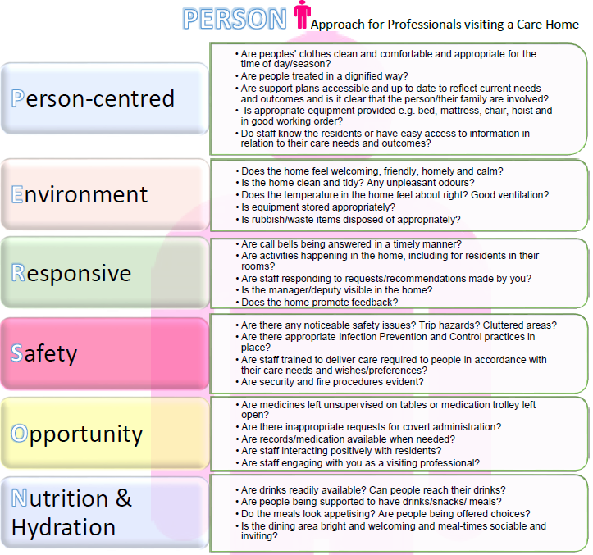
PERSON Approach to professionals visiting residential settings
Notes:
Nic/ James

Slide 14
The PERSON Approach to Professionals Visiting residential settings
This will aid teams in what to look out for in terms of the quality of care, which might not be related directly to the task in hand and encourages professionals to be reminded where opportunities may exist to challenge or celebrate the quality of care
Where quality related issues are identified, visiting professionals are encouraged to discuss these in the first instance with the Home Manager and complete the PERSON form; however, where appropriate discuss within their Safeguarding Concerns Manager and/or raise a safeguarding concern, if appropriate
Feedback will support our approach to early intervention and identify best practice across the provider market and allows an integrated approach on developing and delivering local approaches to prevention
Notes:
Nic/ James

Slide 15
Organisational abuse, Care Act Statutory Guidance, March 2024
Organisational abuse is defined as,
“including neglect and poor care practice within an institution or specific care setting such as a
hospital or care home, for example, or in relation to care provided in one’s own home.
This may range from one off incidents to on-going ill-treatment.
It can be through neglect or poor professional practice as a result of the structure, policies, processes
and practices within an organisation.” Care and support statutory guidance, updated March 2024
Notes:
Nicola W

Slide 16
Types of organisational abuse or institutional abuse
Discouraging visits or the involvement of relatives or friends
Run-down or overcrowded establishment
Authoritarian management or rigid regimes; lack of leadership and supervision; insufficient staff or high turnover, resulting in poor quality care
Abusive and disrespectful attitudes towards people using the service; failure to manage residents with abusive behaviour
Inappropriate use of restraints, including misuse of medication
Lack of respect for dignity and privacy; not offering choice or promoting independence
Not providing adequate food and drink, or assistance with eating
Failure to provide care with dentures, spectacles or hearing aids
Not taking account of individuals’ cultural, religious or ethnic needs
Failure to respond to abuse appropriately; failure to respond to complaints
Interference with personal correspondence or communication
Many forms of abuse are criminal offences and should be treated that way
Social Care Institute for Excellence (SCIE) link: Types of organisational or institutional abuse: SCIE
Notes:
NW
This list is not exhaustive

Slide 17
Signs and indicators of organisational abuse
Lack of flexibility and choice for people using the service
Lack of management overview and support; inadequate staffing levels
Poor standards of care; people being hungry or dehydrated
Lack of personal clothing and possessions and communal use of personal items
Lack of adequate procedures; poor record-keeping and missing documents
Absence of visitors
Few social, recreational and educational activities
Public discussion of personal matters
Unnecessary exposure during bathing or using the toilet
Absence of individual care plans
Social Care Institute for Excellence (SCIE) link: Types of organisational or institutional abuse: SCIE)
Notes:
NW
This list is not exhaustive

Slide 18
Working in partnership with people who use services, their families, representative or professional advocate
It is essential that people using the service, their family, representative or professional advocate are spoken to and encouraged/ supported to raise complaints and safeguarding concerns.
This includes when, care or support is not provided according to the support plan or is not delivered when expected or is not provided with dignity and respect.
Notes:
NW

Slide 19
Raising a safeguarding concern without consent
The person raising the concern should check with the adult at risk if they give consent for the safeguarding concern to be raised, but sometimes it is necessary to raise even if it is contrary to the wishes of the person.
The following needs to be considered:
Where there is a concern regarding a person's capacity, has the person’s mental capacity been assessed?
Is it in the person’s best interests?
Is the person subject to coercion or undue influence, to extent that they are unable to give consent?
Is it in the person’s vital interests, to prevent serious harm or distress, or is it a life-threatening situation?
Is it in the public interest? e.g. is there a risk to others, where a member of staff or volunteer is involved, or the abuse has occurred on property owned or managed by an organisation with a responsibility to provide care
There is a duty of care for provider organisations and for those working with adults
Notes:
NW

Slide 20
Raising a safeguarding concern North Yorkshire Council electronic form
Follow your own organisations procedure, which must be in line with the Joint multi-agency safeguarding adults policy and procedure (West Yorkshire, North Yorkshire and City of York) available here:
NYSAB (safeguardingadults.co.uk)
Raise a safeguarding concern via the online form
Access North Yorkshire Council’s online forms via the link below
Safeguarding vulnerable adults | North Yorkshire Council
Notes:
NW
Online form is the preferred method for professional raising a safeguarding concern.

Slide 21
Duty of candour and Provider responsibilities - under Organisational Safeguarding
The duty of candour is to promote a culture of openness, transparency and candour in all organisations providing care and support.
The duty is part of the fundamental standard requirements for all providers.
To fulfil the duty of candour, an apology must be given by the provider for the harm caused, regardless of fault, as well as being open and transparent about what has happened.
It applies to all NHS Trusts, Foundation Trusts and Special Health Authorities from October 2014 and for all other service providers or Registered Managers, from April 2015, under Regulation 20 of the Health and Social Care Act 2008 Regulated Activities) Regulations 2014.
Notes:
NW

Slide 22
North Yorkshire Council
North Yorkshire Council is the lead organisation which will coordinate the Organisational Safeguarding response, under the procedure.
Service Manager (Adult Social Care, NYC),
Will work closely with the Quality Team when making the decision to progress into Organisational Safeguarding procedures;
Coordinate the organisational safeguarding and chair meetings
Communicate with all partner organisations.
Quality Team (Health and Adult Services, NYC)
Will work closely with the Service Manager and be involved in the decision making and will attend all meetings regarding Organisational Safeguarding.
Notes:
NW

Slide 23
Care Quality Commission (CQC)
The Care Quality Commission (CQC) has civil and criminal enforcement powers.
The CQC’s role is to monitor, inspect and regulate services to make sure they meet the fundamental standards of quality and safety.
For safeguarding, they will do this by checking that care providers have effective systems and processes to help keep children and adults safe from abuse and neglect.
See this link to the CQC website: https://www.cqc.org.uk/
Notes:
Fiona

Slide 24
Partner Organisations involved in Organisational Safeguarding
A range of partner organisations may be involved in organisational safeguarding.
There will be a range of interventions and support to the provider, which includes the following.
Quality Market interventions (via the Quality Pathway)
Commissioners of Healthcare, Integrated Care Board, who will liaise with primary health, as appropriate
Infection Prevention Control (IPC)
Serious Incidents or Reporting of Injuries, Diseases and Dangerous Occurrences Regulations 2013, RIDDOR Health and Safety Executive, HSE)
Secondary health, as appropriate
North Yorkshire Fire and Rescue.
N.b. this list is not exhaustive
Notes:
Fiona
Commissioners are responsible for ensuring that the service meets the assessed needs of adults and that regular reviews are carried out.

Slide 25
Organisational Safeguarding Five staged approach
Notes:
Fiona

Slide 26
Stage 1: Decision to initiate organisational safeguarding
1.Service Manager & Quality Team complete Information Gathering Risk Assessment
2.Service Manager makes decision supported by Quality Team
3.Initial Organisational Safeguarding meeting
convened within 5 days of decision
4.Provider receives an invitation to meeting, summary of concerns and Provider Improvement Plan template, to produce a Provider Improvement Plan and return it, within 5 working days of the initial meeting
5.Service Manager and Quality Team validate the plan and confirm with the provider
Notes:
Fiona
The Service Manager (Adult Social Care) with the Quality Team will complete the Information Gathering and Risk Assessment which support proportionate decision making and professional judgment
The Registered Manager/ Nominated Individual of provider services, is the point of contact for organisational safeguarding and will be invited to attend the initial organisational safeguarding meeting and review meetings.
The Provider is responsible for providing a ‘Provider Improvement Plan’ detailing how they will address concerns and risks identified; and will update this following the meeting and send to the Service Manager and Quality Team for validation.

Slide 27
Police involvement
The police must be notified in the first instance of any safeguarding concerns regarding abuse or neglect where there is a concern that a crime has been committed.
The Police will decide on what action to take.
As much information should be shared with the provider as possible without compromising any subsequent lines of enquiry.
For more information regarding criminal investigations – See Joint Multi-Agency Safeguarding Adults Policy and Procedures
Possible offences which may apply, include the specific offences, as follows:
Section 44 of the Mental Capacity Act 2005 makes it a specific criminal offence to willfully ill-treat or neglect a person who lacks capacity.
Section 127 of the Mental Health Act 1983 creates an offence in relation to staff employed in hospitals or mental health nursing homes where there is ill-treatment or willful neglect.
Sections 20 to 25 of the Criminal Justice and Courts Act 2015 relate to offences by care workers and care providers.
The Vulnerable Assessment Team, (VAT) North Yorkshire Police are the agreed point of contact for Adult Social Care when responding to concerns regarding organisational safeguarding.

Slide 28
Risk Assessment and RAG Rating within Organisational Safeguarding
Level of Risk (RAG) | Impact of people using the service | Indicative frequency of monitoring
Red | People who use the service are not protected from unsafe or inappropriate care. The provision of care does not meet quality & safety standards. | Following suspension from the Approved Provider List (APL) or Block Contract, a formal meeting will be undertaken with the provider and the provider will produce a Provider Improvement Plan. Where a Provider Improvement Plan is already in place this will be monitored, and further meetings will be held until the Provider Improvement Plan is met. Monitoring will be undertaken via the Multi-Agency Quality and Market Support Review Board, as well as monitoring improvements in quality, by the Quality Team., which may include announced and unannounced Quality Improvement Visits, self-assessments and feedback from professionals, people who use services, their families, representative or advocate, will be sought, where possible.
Amber | People who use the service are generally safe, but there is a risk to their health or wellbeing. Provision of care is inconsistent and may not always meet quality and safety standards. | Quality Team will undertake a heightened level of monitoring of improvement in quality which may include announced and unannounced Quality Visits, self-assessments and feedback from people and their families will be regularly sought, where possible. A suspension may be considered. An Organisational Safeguarding meeting/review meeting with the provider will take place to discuss, concerns, progress made and agree or review the Provider Improvement Plan. Progress against the Provider Improvement Plan will be monitored, and further meetings will be held, until the Provider Improvement Plan is met. Contractual action may also be taken.
Green | People who use the service are safe. Provider is meeting meet quality and safety standards | Quality Team will undertake an assessment of risk to determine the risk level applicable to the provider and support improvements work via the Quality Pathway levels of intervention. For sustainability providers will have a 3- and 6-month review to exit Organisational Safeguarding.
Notes:
Fiona

Slide 29
Summary of Concerns template For the provider detailing the concerns
Safeguarding
Risk Notification Returns (RNR’s)
PERSON - Professional Feedback and any trends identified
Serious incidents
Quality Assessment domains:
1. Involvement & Information
2. Personalised Care & Support
3. Safeguarding & Safety
4. Suitability of Staffing
5. Quality of Management
Notes:
Fiona

Slide 30
Provider Improvement Plan Optional template is available
The Provider is expected to produce a Provider Improvement Plan detailing how they will address these concerns raised, which is discussed and reviewed within the meeting.
The Provider Improvement Plan is returned to the Service Manager and Quality Team, within five working days after the meeting.
Provider Improvement Plan Template (Optional)
Name of provider: Location ID if applicable: Date received from Provider: Validated: Y/N Service Manager: Quality Team: Date:
Area of Risk/Concern
Notes:
Fiona

Slide 31
Stage 2: Initial Organisational Safeguarding meeting Within 5 days of the decision being made
Attendees:
Service Manager (Chairperson)
Quality Team
Police (if required)
Provider i.e. Registered Manager or Nominated Individual), Health Commissioners, CQC
N.b. list is not exhaustive
To discuss:
New/ongoing safeguarding concerns,
The Provider to give an update on their Provider Improvement Plan to address the concerns,
Interventions to support the provider
Review risk and update on contractual/ commissioning decisions
Actions including dates for completion
Communication Plan with people who use the service/ their families/ representatives/ Professional advocate
Date for next meeting
After the meeting:
Provider submits an updated Provider Improvement Plan to the Service Manager within 5 working days of the meeting
Service Manager and Quality Team validates the Provider Improvement Plan
within 2 working days of receipt .
To ensure a proportionate approach to risk
Confirm with the provider whether the plan is acceptable/ not acceptable
If Improvements are not made by the provider this is escalated to Senior Managers in Adults Social Care
Notes:
Fiona

Slide 32
Communication Plan & checklist
The provider is responsible for writing to and informing people who use their service, their families, representative or advocate, in a timely way, regarding concerns about their service; and to reassure people that they are working with the local authority, partner organisations and the Care Quality Commission (N.b. only if they are a Regulated service provider), to address the concerns raised.
Support is available to the provider from the Quality Team with producing correspondence.
In a residential or nursing setting, people who use the service, their families, representative/ advocate, may become anxious about increased activity, for example, seeing more visiting professionals come into their home and they have the right to be informed.
Care should also be taken not to raise their anxiety and ensure transparency throughout the whole process.
Notes:
James/ Nic

Slide 33
Communication plan & checklist
Meetings with people who use the service, their families, representative or advocate
There should be the opportunity for the Service Manager and/or Health Commissioners, to attend meetings with people who use the service, including people who fund their own care, their families, representative or advocate, to give them an opportunity to discuss concerns in confidence, if required. This should be communicated in a timely way to advise them of this.
There will be an agreed approach in place as to how information sharing and on-going communication will be managed.
Provider Service
The Quality Team may support the provider by attending staff meetings and provide reassurance, if required.
Notes:
James/ Nic

Slide 34
Stage 3: Provider review meeting(s) 2-6 weeks or sooner, if required
Attendees:
Service Manager (Chairperson)
Quality Team
Police (if required)
Provider i.e. Registered Manager or Nominated Individual), CQC, Health Commissioners,, other partner organisations
N.b. list is not exhaustive
Review:
New/ongoing safeguarding concerns
Review the Provider Improvement Plan
Interventions to support the provider
Review risk and update on contractual/commissioning decisions e.g. suspension if applicable
Actions including dates for completion
Communication Plan with people who use the service/ their families/ representatives/ Professional advocate
Date for next meeting
After the meeting:
Provider submits an updated Provider Improvement Plan to the Service Manager within 5 working days of the meeting
Service Manager and Quality Team validates the Provider Improvement Plan
within 2 working days of receipt.
To ensure a proportionate approach to risk
Confirm with the provider whether the plan is acceptable/ not acceptable
If Improvements are not made by the Provider this is escalated to Senior Managers in Adults Social Care
Notes:
James/ Nic
If the Provider Improvement Plan is not acceptable or improvements, then it needs to be escalated to Senior Managers
If the provider advises the Service Manager or Quality Service and Continuity Team that they are unable to make sustained improvement or where there is evidence of lack of required improvement, possible service failure or service interruptions escalation to Senior managers is required.
A clear route is identified in the Procedure.
A Summary Briefing Note has been produced as a template.

Slide 35
Stage 4: Quality Assurance 3-6 months review, or sooner if required
Attendees:
Service Manager (Chairperson)
Quality Team
Police (if required)
Provider i.e. Registered Manager or Nominated Individual), Health Commissioners, CQC, Health Commissioners, other partner organisations
N.b. list is not exhaustive
Review:
New/ongoing safeguarding concerns
Review the Provider Improvement Plan
Discuss and review interventions to support the provider
Review risk, Update on contractual/commissioning decisions e.g. suspension if applicable
Actions identified with specified dates for completion
Communication Plan with people who use the service/ their families/ representatives/ Professional advocate
Set date for next meeting
After the meeting:
Provider submits an updated Provider Improvement Plan to the Service Manager within 5 working days of the meeting
Service Manager and Quality Team validates the Provider Improvement Plan
within 2 working days of receipt
To ensure a proportionate approach to risk
Feedback to the provider whether the plan is acceptable/not acceptable
If Improvements are not made by the Provider this is escalated to Senior Managers in Adults Social Care
Notes:
James/ Nic

Slide 36
Stage 5: Exit to Quality Pathway 3-6 months review, or sooner if required
Attendees:
Service Manager (Chairperson)
Quality Team
Police (if required)
Provider i.e. Registered Manager or Nominated Individual), Health Commissioners, CQC, Health Commissioners, other partner organisations
N.b. list is not exhaustive
Review:
New/ongoing safeguarding concerns
Review the Provider Improvement Plan
Discuss and review interventions to support the provider
Communication Plan with people who use the service/ their families/ representatives/ Professional advocate.
Exit Organisational Safeguarding?
The Organisational Safeguarding Process will come to an end and the decision will be recorded in the minutes of the Organisational Review meeting as evidence- based improvement
Notes:
James/ Nic

Slide 37
www.safeguardingadults.co.uk
Follow us on Twitter: @NYSAB1
The Organisational Safeguarding Procedure - https://safeguardingadults.co.uk/working-with-adults/nysab-procedures/
One Minute Guides - https://safeguardingadults.co.uk/working-with-adults/one-minute-guides-omg/
Keeping Safe Resources, Easy Read Guides and audio books - https://safeguardingadults.co.uk/keeping-safe/easy-read-guides/
Training brochure and competencies - https://safeguardingadults.co.uk/learning-research/training-courses/
NYSAB Multi-agency safeguarding Procedures - https://safeguardingadults.co.uk/working-with-adults/nysab-procedures/
Resources
& keeping up to date with the NYSAB
Scan QR code:
Twitter
Newsletter
Website
www.safeguardingadults.co.uk/nysab-newsletter
www.safeguardingadults.co.uk
www.twitter.com/nysab1
Notes:
NW

Slide 38
Questions? email: AdultSafeguardingTeam@northyorks.gov.uk HASQuality@northyorks.gov.uk
Notes:
NW

