Slide 1
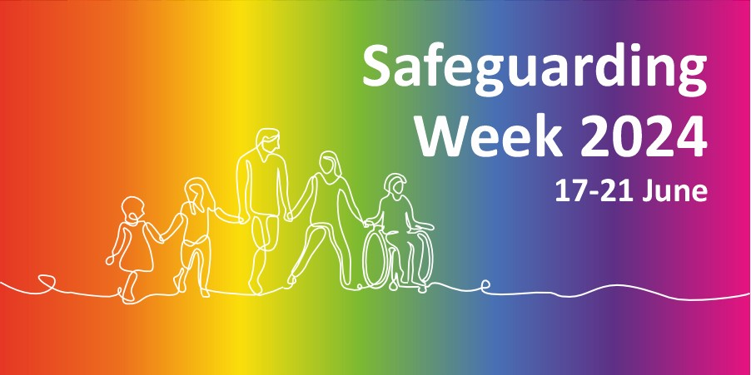
Substance Use, Language & Stigma
Dolly Cook & Rachael Jennings

Slide 2
Notes:
‘’I love this quote by Dr Cherry, I think it captures what we are trying to depict in this presentation well!
The language we use when speaking about or referring to people who use drugs, including alcohol, reflects our values and our feelings, and in turn how we think and act and has a massive impact on how individuals view themselves, and how others view them. Words can be alienating, disempowering, divisive, confusing, and give offense, BUT they can also be considerate, understanding, empowering and moving! It’s easy to use language unthinkingly as it’s so common and we don’t think about the true meaning or impact of our words, or consider why we continue to use them.
What we know is that harms of substance use is impacted by stigma, which is flet by the person, so keeps things in the shadows. We want to develop ways of working which reduces the stigma.
This isn’t a rule book or guide, there is no manual, but shining a spotlight so when we are talking about the problem we are talking about it in an anti oppressive way so that people will/can access support.

Slide 3
Are we being too ‘woke’?
Notes:
Are we being too ‘woke’? Woke is now defined in this dictionary as “aware of and actively attentive to important facts and issues. In preparation for this presentation, when we asked people with lived experience of substance use for feedback on stigmatising language, one person said the ‘world’s gone mad, too politically correct’ and it doesn’t really matter.
BUT DOESN’T IT?
Whilst there are lots of opinions on this and there is no a rule book, but as a collective we are trying to raise the bar and help address any discriminatory practice, including negative self-talk. E.g. “I’m a nightmare”, etc. which serves to confirm a sense of not being good enough. Let’s reframe and focus on the strengths and change about how people think about themselves..
Structural and public stigma such as the ‘war on drugs rhetoric’ perpetuates self-stigma, resulting in barriers to support, and recovery. Families are affected by stigma, while language can also prejudice professionals.
Viewing problem drug and alcohol use as akin to other health issues will help to address stigma and discrimination. Instead of a condemnatory tone, a respectful, compassionate tone could be adopted. Health outcomes improve for people who are described and treated in a non-judgemental manner. By reducing stigma people will feel a greater connection to society, more included and more likely to access treatment and support for recovery.

Slide 4
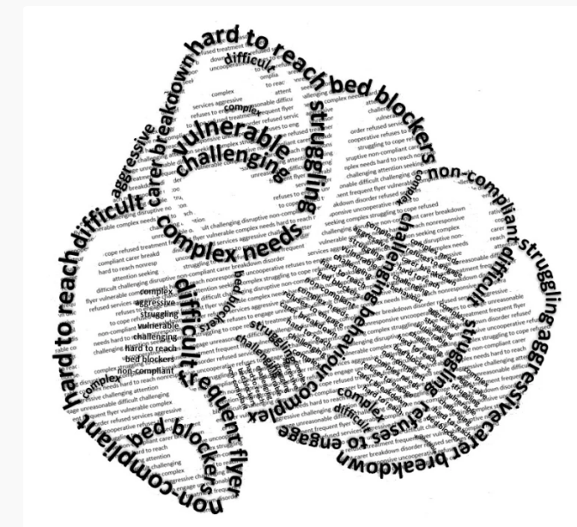
Words that Blame
‘Hard to reach’
‘Refuses to engage’
‘Non-compliant’
‘Complex’
‘Difficult’
‘Vulnerable’
Bryony Shannon: Beyond blame – Rewriting social care
Notes:
Taken from: Beyond blame – Rewriting social care
These terms don’t just feature in our conversations and records. We recruit social workers to work with “non-engagers”, “the most complex and challenging adult cases” and “some of society’s most vulnerable individuals”. We have policies for ‘dealing with difficult families’ and guidance on ‘engaging hard to reach groups’. We have ‘Complex needs teams’ and ‘Challenging behaviour units’.
Hard to reach
Labelling individuals and groups as ‘hard to reach’ implies people are deliberately avoiding contact, keeping their distance, staying away. It places the blame entirely with them. But how hard are we really trying before we slap on that label as a convenient excuse?
Hard to reach? Or easy to ignore?
And couldn’t the ‘hard to reach’ label be just as easily applied to us? Our lack of accessible information and reasonable adjustments. Our jargon and acronyms. Our eligibility criteria. Our thresholds. Our risk assessments. Our waiting lists. Our 9-5, Mon-Fri opening hours. Our city centre offices with security guards on the doors.
We blame individuals and groups for being hard to reach, from behind our impenetrable walls.
Refuses to engage
We use the term ‘refuse’ a lot. Refused an assessment. Refuses services. Refusing treatment.
Refuse suggests defiance, stubbornness. Blaming, again.
What about ‘chose not to’? ‘Decided against’?
What about some acknowledgement of informed decision-making by the person? Of agency? Of control? What about some evidence of a conversation? Of capacity to decide? Weighing up options? Advocacy? Choice?
Was there any?
And what of the classic ‘refuses to engage’? We condemn people for not responding or participating. Not getting involved. But hang on, who exactly should be engaging here? We’re public servants – here to serve, not to get people to serve us. We should be focusing on what matters to people, instead of blaming people for not doing the things that matter to us.
“Again look at the question: ‘how do we get people to engage?’ With respect you don’t get ppl to engage. You listen to what they care about enough to act on, and then support them to work with others to do what they care deeply about. It’s not about getting ppl to do what we want.”
Non-compliant
Compliant means obedient. Submissive. Biddable. It means you do what you’re told. You do what is expected of you, what somebody else thinks you should be doing. So, if we label you as ‘non-compliant’, we’re effectively saying you’re not doing what we want you to do. Because we know best. Obviously.
Complex
Complex cases. Complex individuals. Complex health conditions. Complex lives.
Real lives are complex. Messy. Rainbow coloured crayon scribbles on crinkled and torn pages. Stuff happens – or doesn’t. Too much. Not enough. Stops. Starts. Loops back. Dead ends. Creeping, miniscule shifts. Rapid, devastating changes. Balancing. Juggling. Waving. Falling. Drowning.
Real lives don’t fit the straight lines of our ‘system’, the black and white boxes on our forms. Our processes and pathways require a single label at the start. One ‘primary support reason’. One ‘service user group’. Go.
Too many labels = too many boxes ticked = too many pathways = too many professionals = too many conversations = too many options = too much time = not enough time = not enough options = ‘complex’.
And then often, ‘too complex’.
Of course, ‘complex needs’ is the classic. We’ve even built complexity into the term ‘complex needs’, as the multiple references in the Care Act statutory guidance illustrate. “Multiple and complex needs”. “Highly specialised and complex needs”. “Less complex needs”. “More complex needs”. “Particularly complex needs”. “Higher or more complex needs”. “Complex ongoing healthcare needs”. “The most complex needs”. “Multiple complex needs”. “Complex SEN and care needs”. “Complex health and care needs”. “Complex care needs”. [6]
The guidance contains several case studies, including ‘Isabelle’ who ‘is 15 years old with complex needs’ and Maureen who “is 72 years old.. with complex care needs’. We don’t find out what their needs are, just that they are ‘complex’.
Like ‘challenging’ and ‘vulnerable’, ‘complex’ is a meaningless term – used repeatedly to convey – well, what exactly? Yes, people’s lives may be complicated, but people’s basic needs are simple. Somewhere to call home and to belong. Someone to love, and to be loved in return. Something to do. Something to look forward to.
Stop using labels as excuses.
Difficult
“What starts as a note stating I cried in an appointment, becomes a letter that details a “difficult appointment”, which takes flight as a descriptor of me as a “difficult person”, which ultimately leads to a doctor I only just met describing me as “difficult – as expected.”
Wren [7]Tricky discussions. Feedback we find hard to hear. People experiencing tough times. Difficult conversations and difficult situations quickly morph into just plain ‘difficult’… and yes, it’s pretty much a catch all term for all the other blaming words and phrases listed here too.
Difficult case. Difficult service user. Difficult customer. Difficult patient. Difficult family.
Labels stick.
Vulnerable
And finally, the v-word. Although I’ve already written at length about the term ‘vulnerable’, it’s worthy of a mention here – partly because it’s so ubiquitous, but mainly because it points the finger squarely at the person as the problem and stops any consideration of the external factors that make people vulnerable. And in turn this prevents any focus on – or attempts to change – the situations or circumstances that create vulnerability.
During the pandemic we’ve seen a further sinister step. Not just blaming people for being vulnerable, but in turn blaming ‘the vulnerable’ for ‘restrictive’ (protective!) measures, with tweets like “quarantine the vulnerable – let the rest of us live our lives” and “vulnerable people can just stay inside! Why should the rest of us wear masks??!!” and newspaper headlines including “Boris Johnson speaks of ‘heavy heart’ as Christmas is sacrificed to protect the vulnerable.”
Such a divisive and dangerous narrative.
These blaming terms demonstrate and perpetuate the ‘them and us’ divide that pervades our practice.
We know that connection and relationships must be at the beating heart of our better, brighter social care future. And we also know that blame destroys trust, stifles curiosity and sabotages relationships.
So how do we shift this narrative?
How do we move beyond blame?

Slide 5
Stigma and Substance Use - YouTube
Notes:
Stigma and Substance Use - YouTube

Slide 6
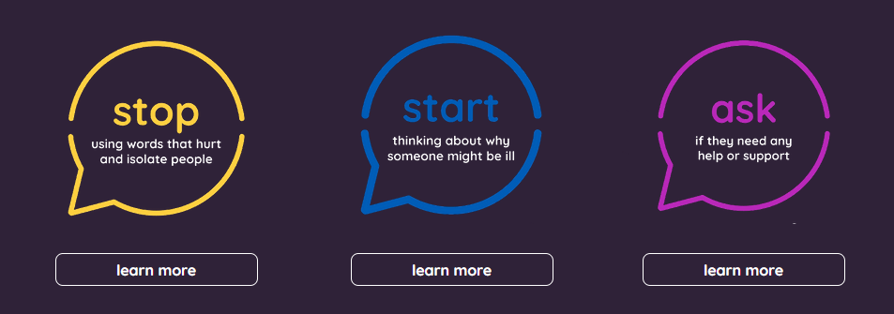
Stigma Kills
International, national and regional research that revealed the causes and consequences of stigma related harms and impacts on the most vulnerable in areas of trauma, substance use and domestic violence.
The importance of combatting stigma related harms was underscored by the mandate to reduce social and health inequalities, drug related deaths, and domestic violence incidents.
Stigma Kills | NHS Addictions Provider Alliance
Notes:
NHS Provider alliance and STIGMA KILLS campaign.

Slide 7
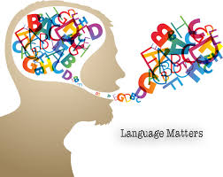
The 3 R’s:
People with Rights,
who deserve Respect, and
should be supported in their Recovery.
NHS-Borders-Language-Matters-Nov-2022.pdf (scot.nhs.uk)
Notes:
Challenging stigma benefits everyone in society, as it helps to build equality and tackle inequality as attitudes and behaviour change over time. While language is significant, it is also important to be mindful of using non-stigmatising images when communicating. Try to use only neutral images, and avoid images of stereotypes of overly positive or negative connotations. We encourage the use of ‘people first’ language; language that focuses first on the person, not the behaviour (e.g. people who use drugs). We do this as it reminds us to be compassionate and that we are talking about human beings.

Slide 8
Notes:
What we have recognised and is starting to happening nationally, is that is we can use more positive language, people will accept support.
Words abuse and misuse suggest people are doing something wrong.
When we say people, we are trying to reduce those power dynamics, respect people, a person with a unique exp rather than “an addict”.

Slide 9
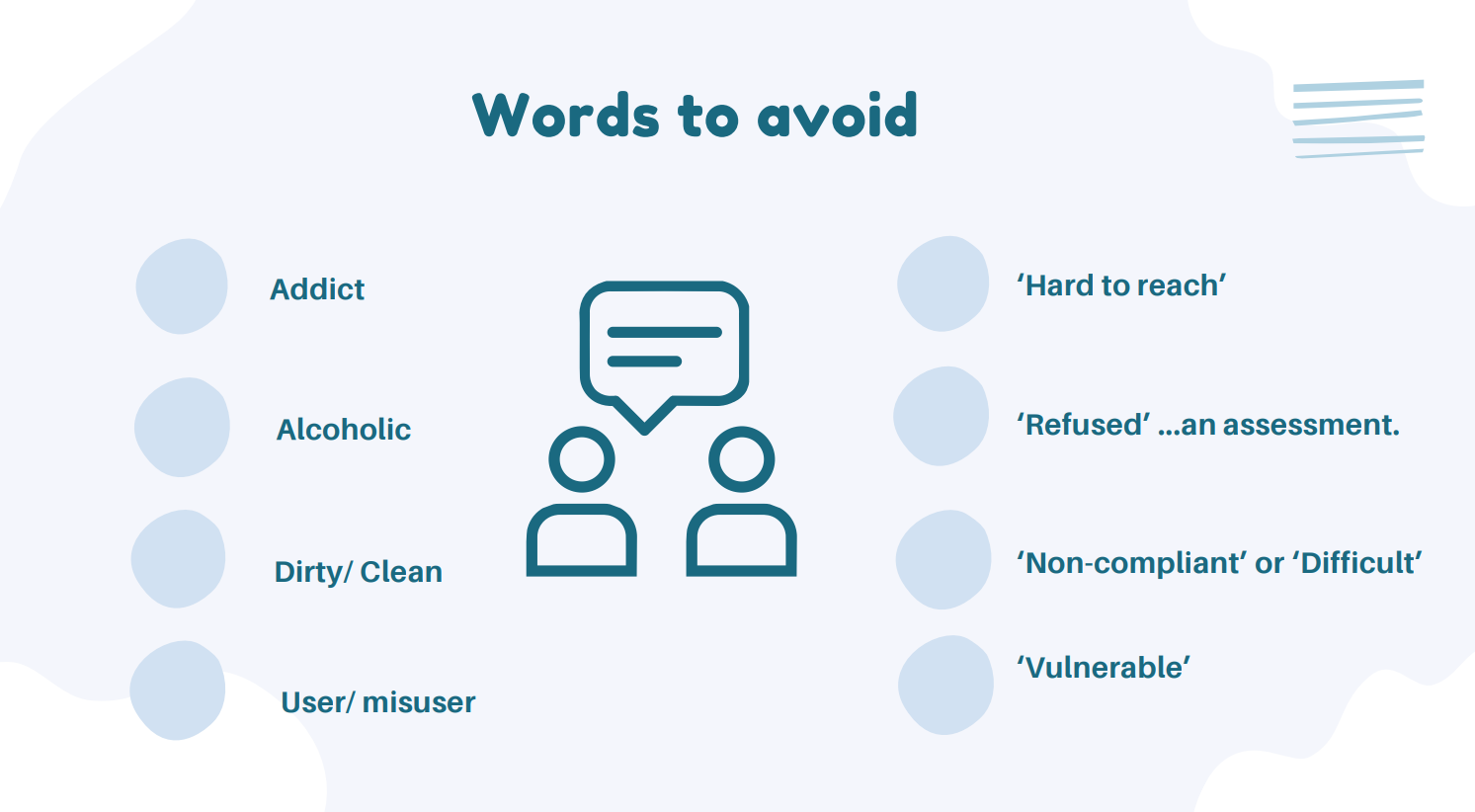

Slide 10
Notes:
Who is it challenging to? Professionals? Services? People aren’t conforming, but we need to see that behaviour through their person’s perspective, looking behind the behaviour? Is there a trauma, have they been heard? Maybe they are angry at the world / system? Developing empathy – when we develop empathy and unconditional positive regard.

Slide 11
Top Tips
What strong, not what wrong!
Emphasise the ‘person’ first - don’t define people by their drug use or diagnosis (e.g. person who uses drugs/person living with hep C – not drug user, she/he’s hep C, etc.)
Don’t impose your language or values on others – check with the person about how they would prefer to be addressed/spoken to and respect their views.
Choose terms that are ‘strength-based’ and ‘empowering’ – avoid ‘non-compliant’ instead ‘chooses not to’/’decided against’ – emphasise agency and choice.
Avoid trivialising, victimising or sensationalising people or drug use - sayings like ‘has a drug habit’ or ‘suffering from addiction’ can be very disempowering.
Use language that is accessible – don’t speak ‘above’ or assume a person’s understanding (incl. avoiding slang and medical jargon - can be misinterpreted and cause confusion especially for people for whom English is not their first language.)

Slide 12
Try not to make assumptions about a person’s identity – be inclusive (e.g. use the person’s name.)
Be aware of the context of the language - some language is OK when used within a community to claim identity, but stigmatising when used by others e.g., “junkie”.
Avoid diminishing people – your language should empower the person (don’t speak to people like children, victims, pathologising or incapable/without agency). Value the perspective of people who use drugs – people who use drugs are experts in their own lives. Ask their opinion and trust their advice!
Communication is not just verbal – use non-verbal, tone of voice, body language to demonstrate respect for the dignity and worth of all people.
Check and challenge – Are you able to challenge stigmatising language in a supportive way? People sometimes don’t know that they are using old language, e.g. ‘sin bin’
Notes:
Sin bin – sporting origins, appropriated in politics, E.g. ‘sin bin for worst families’, 2009 Sin bins for worst families | UK | News | Express.co.uk.

Slide 13
What can you do?
Reflect on how stigma might impact upon the people you help and support.
Consider if you have any embedded personal views that might result in stigmatisation.
Use respectful language and treat people with dignity.
Be trauma-informed, person-centred and professionally curious in your work.
Think beyond the persons presentation and consider what might be going on underneith?
Speak out against stigma if you see it happening.
Join the Anti Stigma Network -
The Anti-Stigma Network | End Stigma Attached to Drug and Alcohol Use (antistigmanetwork.org.uk)

Slide 14
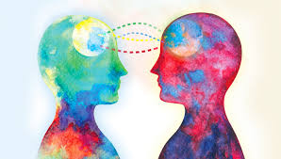
Final thoughts: Beyond Blame… From Furious to Curious. From Correction to Connection
Accountability is essential, but that doesn’t mean we shift the blame and start pointing fingers at colleagues. The blame culture is already far too prevalent and damaging within our organisations. It also doesn’t mean we blame ‘the system’ – because – well, we are the system. And it definitely doesn’t mean we add more tick boxes to our forms to justify our every move. It means we know and follow the law, we’re transparent about our responsibilities and we’re honest about our mistakes and where we need to do better. We acknowledge that we’re still learning, and we welcome – and act on – suggestions about how we improve.
Bryony Shannon, Beyond Blame, 2022: Beyond blame – Rewriting social care
Notes:
Rachael
The language we use when speaking about or referring to people who use drugs, including alcohol, reflects our values and our feelings, and in turn how we think and act and has a massive impact on how individuals view themselves, and how others view them. Words can be alienating, disempowering, divisive, confusing, and give offense, e.g., by defining people solely by consumption of a substance, designating them as ‘others’; inferior or morally flawed. It’s easy to use language unthinkingly as it’s so common and we don’t think about the true meaning or impact of our words or consider why we continue to use them.
Structural and public stigma such as the ‘war on drugs rhetoric’ perpetuates self-stigma, resulting in barriers to support, and recovery. Families are affected by stigma, while language can also prejudice professionals.
Viewing problem drug and alcohol use as akin to other health issues will help to address stigma and discrimination. Instead of a condemnatory tone, a respectful, compassionate tone could be adopted. Health outcomes improve for people who are described and treated in a non-judgemental manner. By reducing stigma people will feel a greater connection to society, more included and more likely to access treatment and support for recovery.

Slide 15
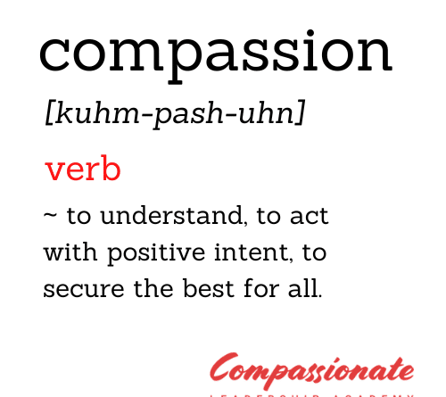
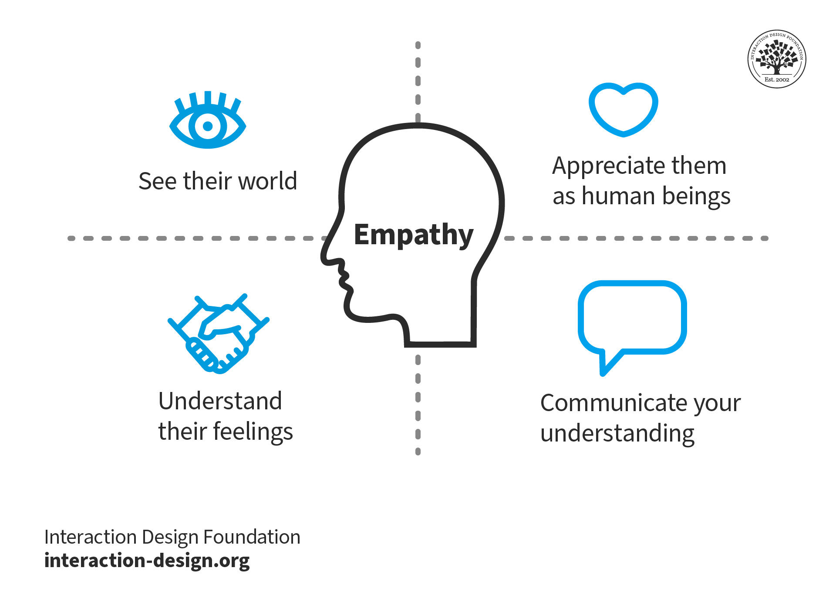
Connection
Notes:
Dolly

