Slide 1
All about the North Yorkshire Safeguarding Adults Board (NYSAB)

Slide 2

The North Yorkshire Safeguarding Adults Board (NYSAB)
The NYSAB exists to protect adults who may be at risk from abuse, by promoting co-operation and effective working practices between different agencies.
The Care Act 2014 sets out a clear legal framework for how local authorities and other parts of the health and care system should protect adults at risk of abuse or neglect.
This gives the Safeguarding Adults Board a clear basis in law.
The Care Act expects Safeguarding Boards to ensure that safeguarding is personal, and that everyone in the community understands it and has a responsibility for supporting it.
www.safeguardingadults.co.uk
Follow us on X: @NYSAB1

Slide 3
The North Yorkshire Safeguarding Adults Board (NYSAB)
The Board is made up of statutory and non-statutory partners from across North Yorkshire
The statutory partners are:
  North Yorkshire Council
  North Yorkshire Police
  Humber and North Yorkshire Health and Care Partnership
It is also supported by non-statutory partners including health trusts, Healthwatch, voluntary sector and community partners, Trading Standards, Probation Service and North Yorkshire Fire and Rescue Service
Our one-minute guide to the NYSAB can be found here: Our Board
www.safeguardingadults.co.uk
Follow us on X: @NYSAB1

Slide 4
The North Yorkshire Safeguarding Adults Board (NYSAB)
The NYSAB supports the aims of adult safeguarding which are to:
Stop abuse or neglect
Prevent harm and reduce risk of abuse or neglect to adults with care and support needs
Safeguard adults in a way that supports them in making choices and having control about how they want to live
Promote an approach that concentrates on improving life for the adults concerned
Raise public awareness so that communities as a whole, alongside professionals, play their part in preventing, identifying and responding to abuse and neglect
Provide information and support in accessible ways to help people understand the different types of abuse, how to stay safe and what to do raise a concern about the safety and wellbeing of an adult, and
Address what has caused the abuse or neglect
www.safeguardingadults.co.uk
Follow us on X: @NYSAB1

Slide 5
Statutory duties of the NYSAB
Have strategic priorities - these are priorities the Board will work on over the next year.
Produce an annual report – To give an overview of the work the Board has carried out in the last financial year. The NYSAB annual reports are published here: NYSAB (safeguardingadults.co.uk)
Carry out safeguarding adult reviews - a process for all partner agencies to identify the lessons that can be learned from serious safeguarding adult cases, where an adult in vulnerable circumstances has died or been seriously injured, and abuse or neglect has been suspected.
www.safeguardingadults.co.uk
Follow us on X: @NYSAB1

Slide 6
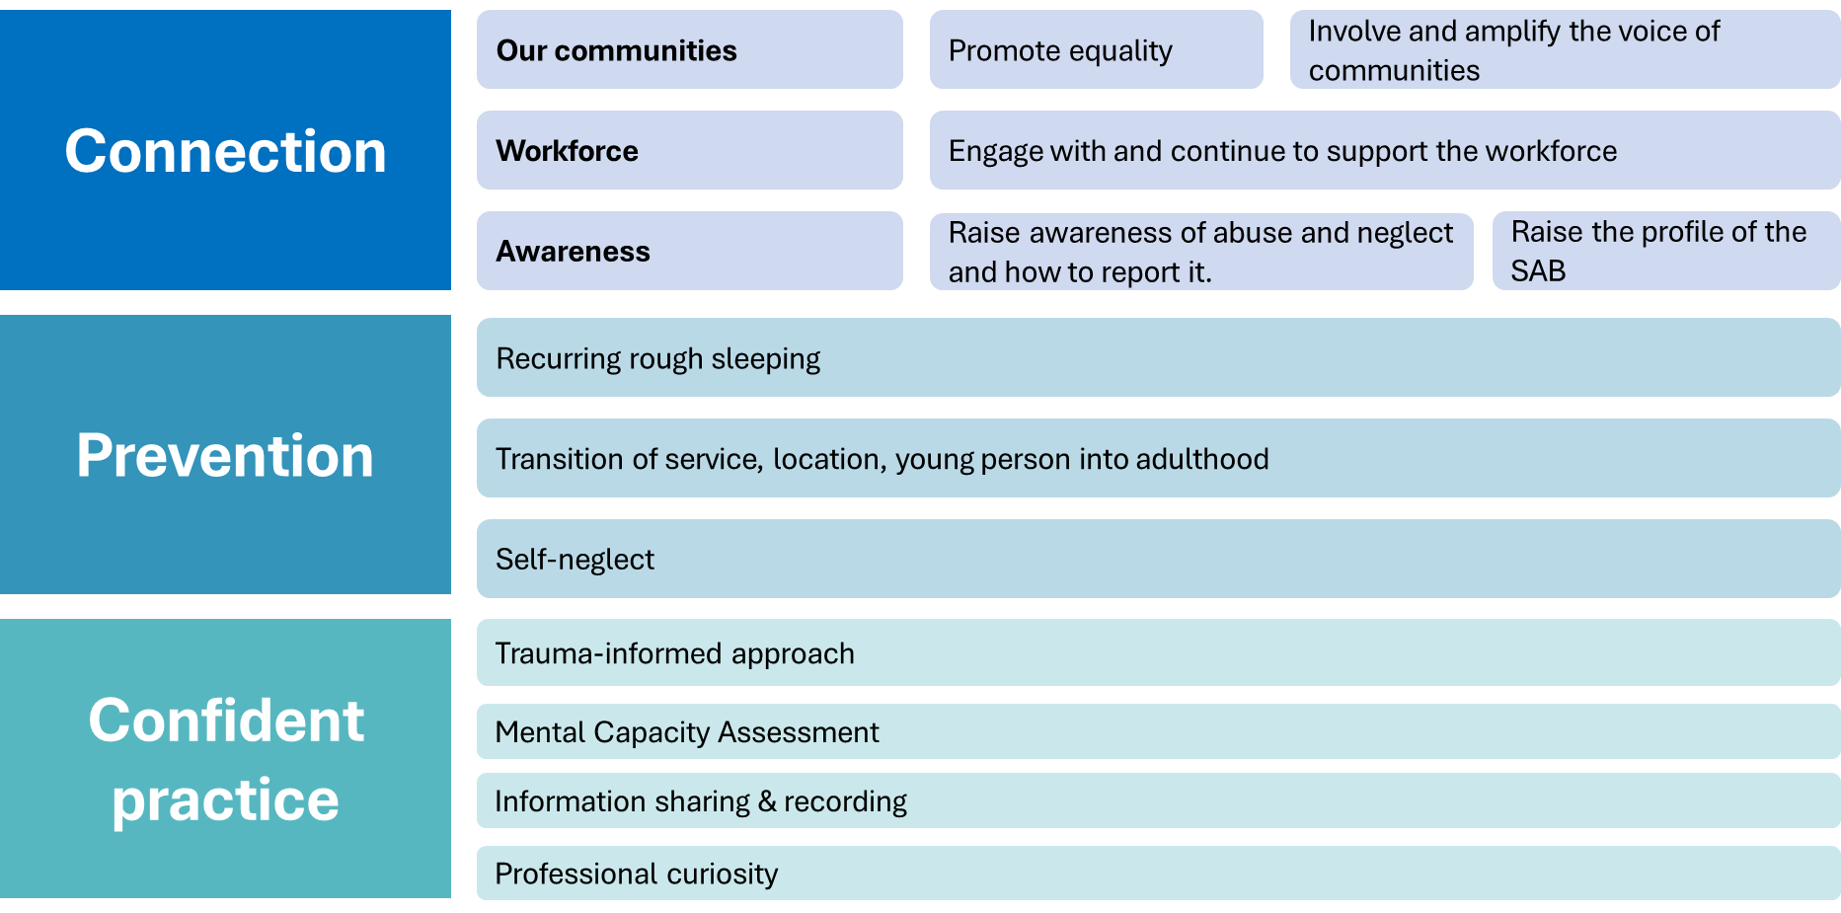
NYSAB Strategic Priorities 2025/2028
Notes:
Our strategic priorities are based on the 6 principles from the Care Act 2014:
Empowerment, Prevention, Proportionality, Partnership, Accountability, Protection

Slide 7
We will connect with our communities by listening, promoting inclusion, and ensuring everyone has fair access to safeguarding support and services.
We will work with partners to support people who are repeatedly rough sleeping or at risk of this, helping to prevent abuse, neglect, and exploitation.
We will embed a trauma-informed approach, ensuring safeguarding responses are compassionate and consider past experiences.
We will support staff to be confident in the use of Mental Capacity Assessments
We will analyse trends and themes from various sources to identify and address safeguarding issues, ensuring our practices are informed and effective.
We will promote a culture of continuous learning and improvement to ensure the workforce remains confident and effective in safeguarding.
We will ensure relevant safeguarding information is captured and shared in a timely way to protect adults at risk.
We will work with partners to ensure smooth and safe transitions between services, reducing safeguarding risks during key life changes.
We will make sure there are enough skilled teams working together to support people at risk of self-neglect.
We will empower communities to share their experiences and influence how safeguarding support is designed and delivered
We will engage with professionals, listen to their challenges, and work together to offer them practical and useful support.
We will support staff to be professionally curious, promoting a culture of questioning and exploration to understand the full context of each situation.
We will raise awareness of abuse and neglect, ensuring everyone knows the signs and how to report concerns.
Notes:
Examples of what we will do under the priorities.
Under each priority is a detailed delivery plan.

Slide 8
Safeguarding Adult Reviews
A Safeguarding Adults Review (SAR) is about learning lessons for the future.
They give the Safeguarding Adults Boards the full picture of what went wrong, so that all organisations involved can improve as a result.
As a result of a detailed review, recommendations are made to change or improve practice and services.
The aim of the process is to learn lessons and make improvements, not to apportion blame to individual people or organisations.
To make a SAR referral, the form can be found here: SAR Policy and sent to nysab@northyorks.gov.uk
www.safeguardingadults.co.uk
Follow us on X: @NYSAB1
Notes:
We are receiving increased requests for SARs

Slide 9
Safeguarding Adult Reviews
The NYSAB commissions independent authors to conduct and write its Safeguarding Adult Reviews and reports. This is best practice.
We are receiving increased requests for SARs – this is a national picture.
Some key themes highlighted by the second national SAR analysis April 2019 – March 2023:
  Safe care at home, power of entry, closed environments and organisational abuse, transitional safeguarding, homelessness, substance use, edge of care.
Our SAR policy and published SAR reports can be found here: NYSAB (safeguardingadults.co.uk)
www.safeguardingadults.co.uk
Follow us on X: @NYSAB1

Slide 10
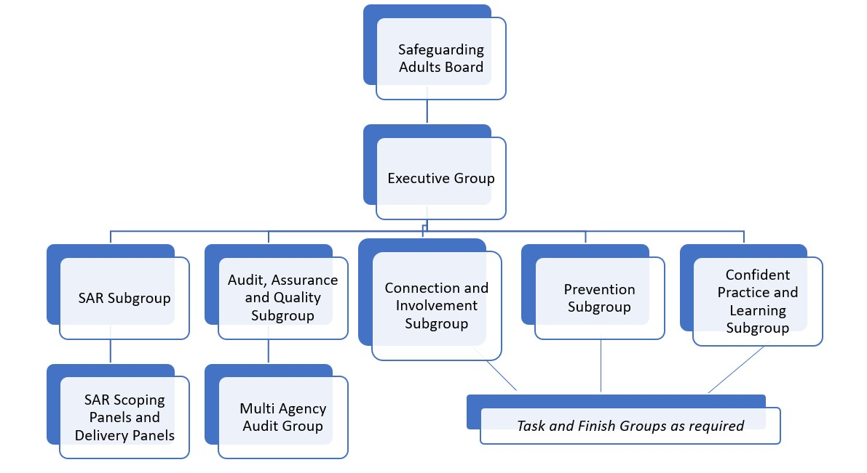

Slide 11
NYSAB Business Unit Support
Adrian Green - Independent Chair
Sally Lichfield, NYSAB Manager
Sarah Abram, Deputy NYSAB Manager
Janice Foxton, Safeguarding Governance Assistant
Hollie Townsend, NYSAB Communications
SAR Learning:
Rachel Craig, Learning and Improvement Officer
Rachael Jennings, Learning and Improvement Officer
Hannah Brown, Review and Improvement Officer
NYSAB Engagement
Erin Outram, Involvement Manager
Ania Deputat, Involvement Officer
www.safeguardingadults.co.uk
Follow us on X: @NYSAB1

Slide 12
Raising a Safeguarding Concern
It is really important any safeguarding concerns are reported to NYC and not to the NYSAB.
Information on raising a concern, including the raising a concern form for professionals, can be found on the NYC website: Safeguarding vulnerable adults | North Yorkshire County Council
This guide also gives an overview: Raising a safeguarding concern
Polices and Procedures:
  Safeguarding Adults Multi-Agency Policy and Procedures (West Yorkshire, North Yorkshire and the City of York): Joint Multi-Agency Safeguarding Adults Policy and Procedures
www.safeguardingadults.co.uk
Follow us on X: @NYSAB1

Slide 13
Safeguarding Week
Yearly in June, Safeguarding Adults Boards, Children’s Safeguarding Partnerships, and Community Safety Partnerships across North Yorkshire, City of York and East Riding come together to put together Safeguarding Week.
The key message of the week is that ‘Safeguarding is everybody’s business’
Developed for both professional and public audiences, sessions are designed to stimulate discussion and share best practice.
Themes and topics are led by current and emerging themes. In the past this has included domestic abuse, financial fraud and scamming, staying safe online, exploitation, mental capacity, homelessness, and self-neglect.
Public-facing sessions are also held locally to raise awareness
We also get involved in National Adult Safeguarding Week in November.
www.safeguardingadults.co.uk
Follow us on X: @NYSAB1

Slide 14
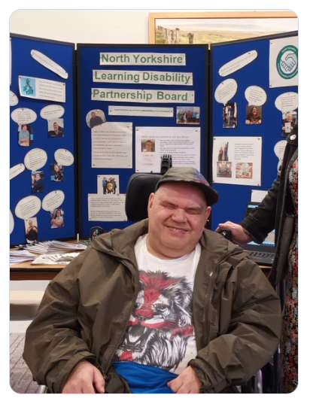
Safeguarding Engagement – People with Lived or Living Experience
Our Keeping Safe Champion!
Sam works with our Involvement team and the board to raise awareness about
keeping safe, important safeguarding topics
and promote the keeping safe resources.
Co-produced safeguarding podcast –
Sam Suttar and Laura Watson:
https://safeguardingadults.co.uk/wp-content/uploads/2021/06/Safeguarding-Podcast-full-episode.m4a
Co-produced Mental Capacity Act (MCA) video and resources following recommendations from the NYSAB: https://youtu.be/2Aef-d-Q8xE
We have plans to expand lived experience involvement into other areas, e.g. Mental Health, rough sleeping, suicide prevention via a “Friends of the Board” programme
www.safeguardingadults.co.uk
Follow us on X: @NYSAB1

Slide 15
How you can support Safeguarding
Complete your Safeguarding training – it is mandatory for every HAS colleague to complete
Get involved with Safeguarding Week – attend the sessions and share the resources
Keep raising awareness beyond safeguarding week – it is important to do this throughout the year, not just during safeguarding week.
Use, share and promote the resources on the NYSAB website and from other providers; if there is something specific you feel we need, please get in touch
Tell us your concerns: raise/encourage people to raise a concern if they are worried about themselves or somebody else who may have experienced abuse and / or neglect.
Become a NYSAB Workforce Champion! – e-mail nysab@northyorks.gov.uk for details
www.safeguardingadults.co.uk
Follow us on X: @NYSAB1

Slide 16
Safeguarding Resources
The NYSAB website has a range of resources for those who work with adults, and they can be found here: NYSAB Website
Some areas to check out on the above are:
  Training Information: Training and Courses
  One Minute Guides NYSAB: One Minute Guides
  Safeguarding Adults Multi-Agency Policy and Procedures (West Yorkshire, North Yorkshire and the City of York): Joint Multi-Agency Safeguarding Adults Policy and Procedures
Other resources:
  SCIE: Safeguarding adults – SCIE
  LGA: Safeguarding resources | Local Government Association
  Ann Craft Trust: Ann Craft Trust: Safeguarding Adults
www.safeguardingadults.co.uk
Follow us on X: @NYSAB1

